Slide 1
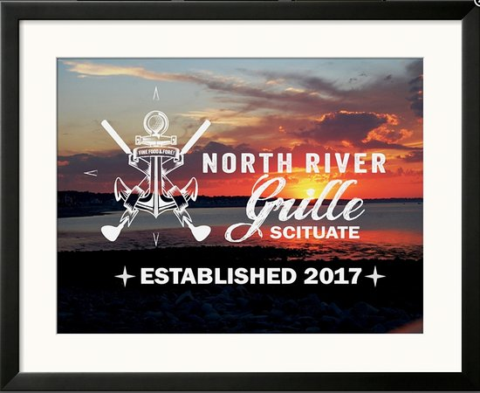

Slide 2

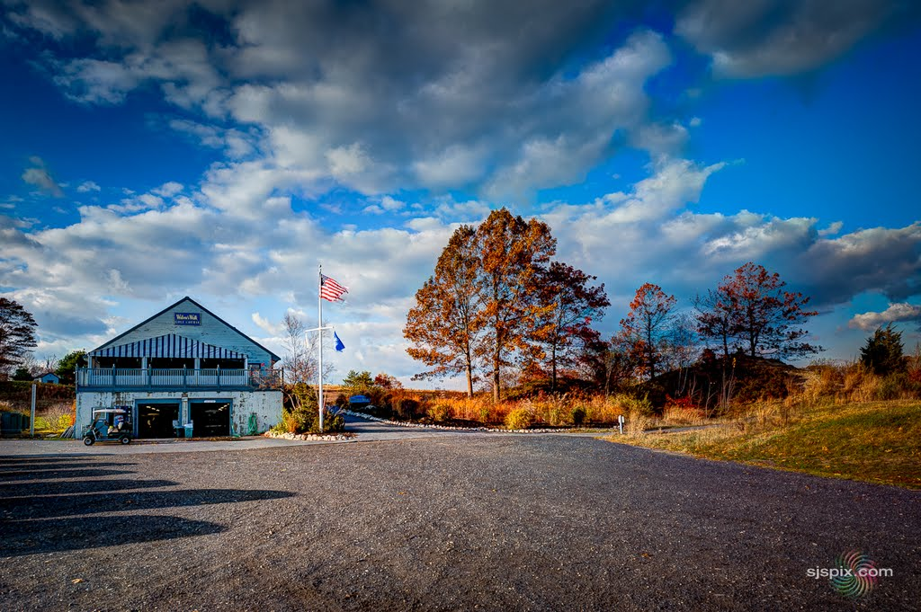
ABOUT NRG
Located in Scituate, MA
Part of the Widows Walk
Golf course
Operated by Mary Quatrucci
Restaurant caters to the golfers
needs as they are the main clientele
Pub-Style bar and grille

Slide 3
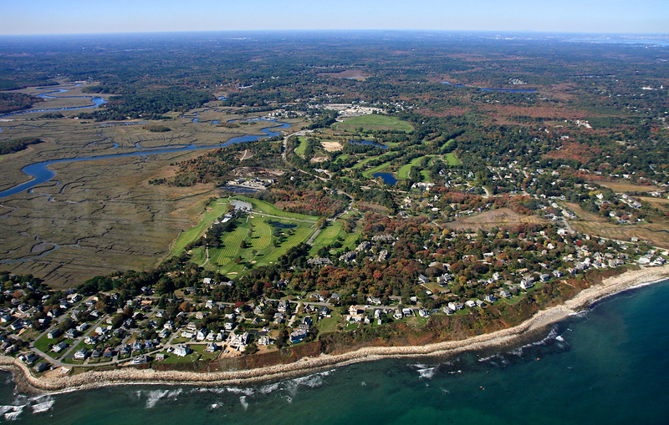
Project Plan:
GitHub https://github.com/Clenoci/NRG-Mobile-Application.git
Gather Information from North River Grille
Divide up work
After every step, review, revise then move on.

Slide 4
Project Plan: Schedule
2017/11/5 – Met with Mary Quatrucci; Gathered information
2017/11/15 – Group meeting to plan and divide work
2017/11/28– Group meeting; peer review and made revisions
2017/12/6 – Review all work; Finish presentation; Plan future work
2017/12/7 – To present a working product to the class
2017/12/9 – To make functional and aesthetic improvements
2017/12/12 – To begin improving ease of use and
doing some Quality Assurance
2017/12/15 – To present it to the head chef;
Get feedback and make any necessary changes
2017/12/22 – To submit the final, working product

Slide 5
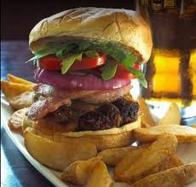
Software Requirements: Functional
Customer will press button on home screen to bring up the menu
Customers will be able to look through the limited turn menu
Customers will be able to create an order of as many items as they like and send it to the restaurant
The orders placed by Customers will be sent to the main computer in the restaurant and then printed out to be made.
Customers will be able to add name to their order for easier checkout upon pickup
Application will give a digital receipt upon placing order

Slide 6
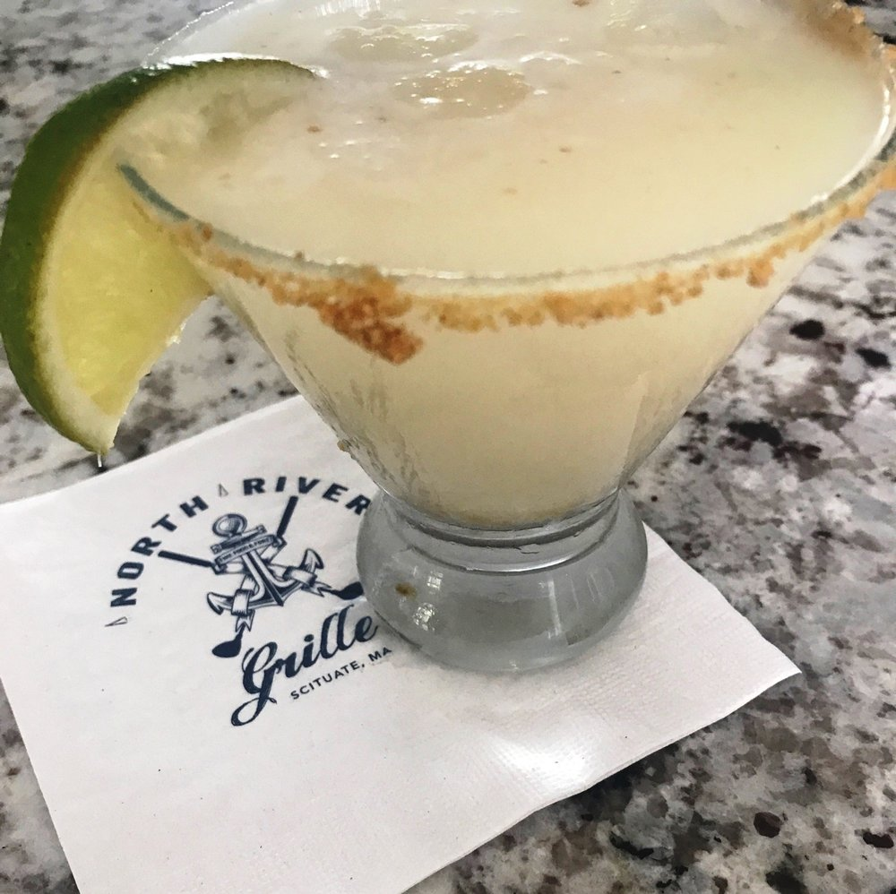
Software Requirements: Non-Functional
Open a welcome screen
Menu is broken down into subcategories to make finding items easier
When and item is added to the order a Toast will pop up letting them know it was added to their cart
Hzfhkj
dfnkdfd

Slide 7

Design
Java
Android Studio
Simple, easy to use
Function over aesthetics
Focus on ease of use – make easier than calling in the order
Blue and white color Scheme

Slide 8
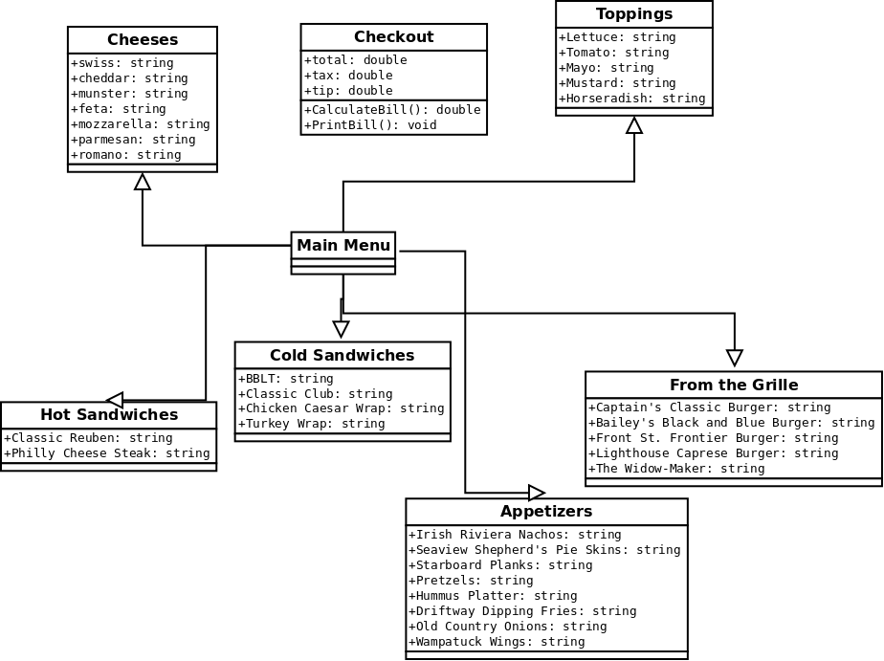
Design: Class Diagram

Slide 9
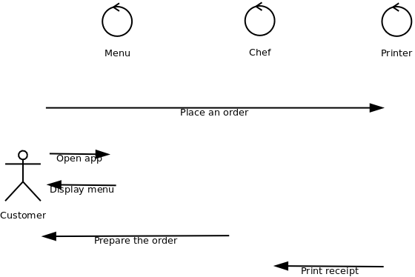
Design: Sequence Diagram

Slide 10
Test Plan
Try items in every category.
Try deleting
Put through fake orders designed to test every aspect of the app.
Minimize tests and be efficient
Test on different types of Android phones(old, new)
Test on different network than the printer
Test with no internet connection
With App still in development test case’s
may vary

Slide 11
Future Plans
Finish Android Application
Improve aesthetics
Create IOS Application
Timed orders
Expand for regular take-out
Accounts: recently ordered, favorites
Weekly Specials
86 items: If currently out, block from ordering
Messaging(Alexa integrated if any questions with orders)

